Slide 1
From Zero to Hero: The Journey of Mastery
Aka: Chapter 5

Slide 2
SCENARIO 1:
You all have been to a wedding before and participated in the cha-cha slide.
Do you think you have “MASTERED” this dance?
LET’S SEE YOUR MOVES IN ACTION!
Notes:
How many weddings have you all been to?
How many cha cha slides have you danced to?

Slide 3
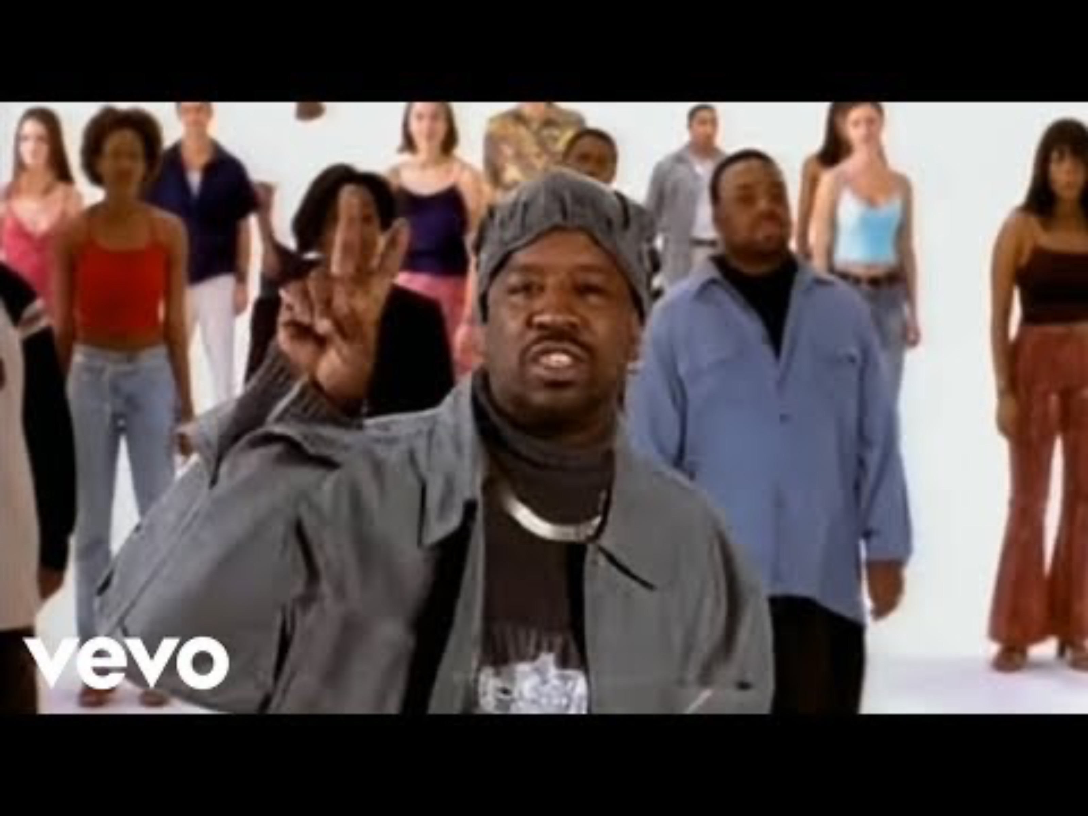
LET’S DANCE! DANCE! DANCE!...and CLAP! 00:51

Slide 4
ELEMENTS OF MASTERY:
Know when to APPLY skills
At a wedding! Maybe not at the bus stop
PRACTICE integrating skills
As many times as possible with a dance partner.
ACQUIRE component skills
Dance as often as possible to flex your skills!

Slide 5
SPECTRUM OF MASTERY:
You look around and see that someone is a beat or two behind but doesn’t realize they shouldn’t be leading!
Unconscious incompetent
You look to the left and see that your friend is mouthing “cha cha real slow? What do I do?!?!!??!”
Conscious incompetent
You look to the right and see that your friend is counting their steps and the words with every beat.
Conscious competent
You look behind and see Logan having the time of his life, eyes closed, hitting every step!
Unconscious competent

Slide 6
EXPERT BLINDSPOT
You ask Logan for some help and he says “You got to the left, go to the right, two stomps, and keep going. It’s simple.”
What is the problem here?
What are some of the ways to identify and work on Logan’s blindspot?

Slide 7
STRATEGIES
Break down complex tasks
Explain only the first 2 parts of the dance and repeat
Reducing extraneous cognitive load
Take them off the dance floor into the hallway! (environmental noise)
Turn off the music (technological noise)
Use comparisons to identify deep features
Apply the steps to different songs
Specify skills or knowledge and ask to identify contexts in which they apply
You don’t do these dances at a funeral

