Slide 1
How Learning Works: Chapter 3
How does the way students organize knowledge affect their learning?

Slide 2
Example
Second year resident successfully complete 10 abdominal hysterectomies. The residents is assisting you for an abdominal hysterectomy for a patient with stage 4 endometriosis. The residents struggles throughout the case to identify the anatomy and key steps of the procedure.
Both the attending and resident express frustration with the case.
What do you think is happening here?
Notes:
Linear pathway

Slide 3
Principle
How students organize knowledge influences how they learn and apply what they know

Slide 4
Objectives
Understand knowledge structures and organization
Understand the difference between superficial recall, critical thinking and higher order connections/organization
Identify strategies to help learners develop more connected, meaningful, and flexible was of organizing their knowledge.

Slide 5
Knowledge Organization
Focusing on arrangement and connection in an individuals mind as oppose to focusing on particular pieces of knowledge
Knowledge can be organized in ways that either do or do not facilitate learning, performance, and retention
Experiences influence knowledge organization - context matters and is not uniform

Slide 6
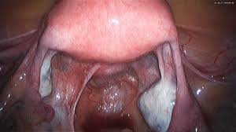
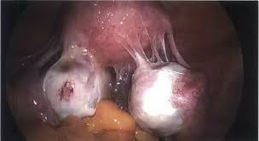
Novice vs Expert
Anatomy -> step of surgery -> understanding complications -> ability to perform procedure in complex patient
Novice tend to build sparse superficial knowledge
Experts have rich, meaningful, knowledge structures

Slide 7
Experts; Versus Novices’ Knowledge organizations: The density of connections
Novice – linear connections – able to perform a basic hysterectomy
Expert – denser connections – can modify technique and procedure based on complex access and use knowledge more efficiently and effectively

Slide 8
Experts’ versus students’ Knowledge Structures: The Nature of Connections
The better learners are able to connect information to meaning
Prepping for surgery, meeting/following a patient, resident clinics.

Slide 9
Strategies to Reveal and Enhance Knowledge Organizations
Analyze your own knowledge organization – concept mapping
Identify most appropriate knowledge organization
Provide students with organizational structure -explicit organization of lecture/lab, explicitly highlight deep features
Exposing students knowledge organization – creating concept maps and sorting tasks.

