Slide 1
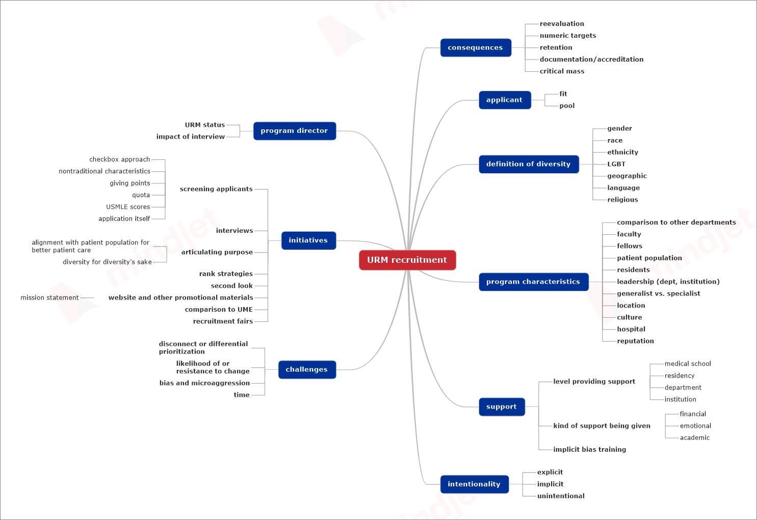
Recruiting Underrepresented Minority Residents to Residency: A Qualitative Study of Strategies Employed by OB-GYN Program Directors
Monica Mendiola, MD^{1,2,} Anna Modest, PhD^{1,2,} Grace Huang, MD^{3,4}
¹Department of Obstetrics and Gynecology, Beth Israel Deaconess Medical Center, Boston, MA
²Department of Obstetrics, Gynecology and Reproductive Biology, Harvard Medical School, Boston, MA
^{3.} Department of Medicine, Beth Israel Deaconess Medical Center, Boston, MA
^{4.} Department of Medicine, Harvard Medical School, Boston, MA
BACKGROUND
Figure 1. Coding MINDMAP with Parent Codes
The Accreditation Council for Graduate Medical Education (ACGME) released new requirements in 2019
Programs must “engage in practices that focus on mission-driven, ongoing, systematic recruitment and retention of a diverse and inclusive workforce” focusing on minorities underrepresented in medicine (URIM)
Using semi-structured interviews of ob-gyn program directors across the country, our study aimed to elucidate the current rationale for the strategies used to recruit URIMs and the perceived barriers to successful recruitment
METHODS
An email soliciting interest in participating in interviews was sent to all ob-gyn program directors between August 2018 and October 2019
Fourteen semi-structured interviews were successfully conducted with representation from all 5 Council on Resident Education in Obstetrics and Gynecology (CREOG) regions
One author conducted and recorded the phone interviews which were anonymized and transcribed by a third-party vendor
All authors reviewed and coded the transcripts using a consensus-based process and identified major themes
CREOG REGIONS
CONCLUSION
REGION 1 Connecticut, Maine, Massachusetts, Newfoundland, New Hampshire, New York, Nova Scotia, Quebec, Rhode Island, Vermont
REGION 2 Delaware, Indiana, Kentucky, Michigan, New Jersey, Ohio, Ontario, Pennsylvania
REGION 3 District of Columbia, Florida, Georgia, Maryland, North Carolina, Puerto Rico, South Carolina, Virginia, West Virginia
REGION 4 Alabama, Arkansas, Illinois, Iowa, Kansas, Louisiana, Manitoba, Minnesota, Mississippi, Missouri, Nebraska, Oklahoma, Tennessee, Texas, Wisconsin
REGION 5 Alberta, Arizona, Armed Forces District, British Columbia, California, Colorado, Hawaii, Nevada, New Mexico, Oregon, Utah, Washington
Program directors use a variety of initiatives across the country
Much work needs to be done to enact the ACGME initiative
RESULTS
Themes Identified:
Wider definition of diversity than traditionally considered, including gender and sexual orientation
Initiatives from URIM recruitment: broadening the initial screening criteria, doing holistic reviews, and promoting diversity on the interview day
Results of initiatives: reaching a critical mass to help future recruitment
Challenges: bias, disconnect amongst leadership and need for more support systems.
REFERENCES
ACGME Common Program Requirements July 2019
ACGME Program Specific Requirements July 2019

